Slide 1
CS 303-Software Engineering Lecture 1
By
Sara Rehmat
MS (CS)

Slide 2
General Information
Grade Distribution:
Assignments: 20%
Quizzes: 10%
Midterms (30%)
Final Exam (40%)

Slide 3
Text Books
Software Engineering: A Practitioner’s Approach, 6th Ed. Roger S. Pressman, McGraw-Hill, 2009
Software Engineering, 9th Ed. Ian Sommerville. Pearson Education

Slide 4
Course Objectives
Students will learn the major software engineering issues such as software requirements, design, process, and management.
Students will also conduct team projects to practice how to apply major software engineering concepts and methods to software development problems.

Slide 5
Course Outline
Will be shared in the next class

Slide 6
What is Software?
What is software?
Software is: (1) instructions (computer programs) that when executed provide desired features, function, and performance; (2) data structures that enable the programs to adequately manipulate information and (3) documentation that describes the operation and use of the programs.

Slide 7
Types of Software
There are two types of software :
System software
Application software
Application Software
An application software is any program, or group of programs, that is designed for the end user.
E.g. database programs, word processors, Web browsers and spreadsheets.
System software
System software is a type of computer program that is designed to run a computer's hardware and application programs. System software is of three main types :
Operating system
Language processor
Utility software

Slide 8
Types of Application Software
Generic products
Stand-alone systems that are marketed and sold to any customer who wishes to buy them
Examples – PC software such as graphics programs, project management tools; CAD software; software for specific markets such as appointments systems for dentists
Customized products
Software that is commissioned by a specific customer to meet their own needs
Examples – embedded control systems, air traffic control software, traffic monitoring systems

Slide 9
Importance of Software
Software is everywhere.
The economies of ALL developed nations are dependent on software.
More and more systems are software controlled.
Indian companies in this field attract attention with their astronomical turnovers. Indian software companies, which had a turnover of $ 12 billion in 2001, had a total income of $ 87 billion in 2008.

Slide 10
History
Back in the late '50's and early '60's, programmers didn't even interact directly with computing devices.
They delivered their programs by hand to technicians and then picked up the results hours later after the programs were batch processed with many others.
But the transition to using a time-sharing model instead of batch processing for running programs led to a rapid growth in computing applications.
Moreover, the increase in computing power also led to development of more software systems.

Slide 11
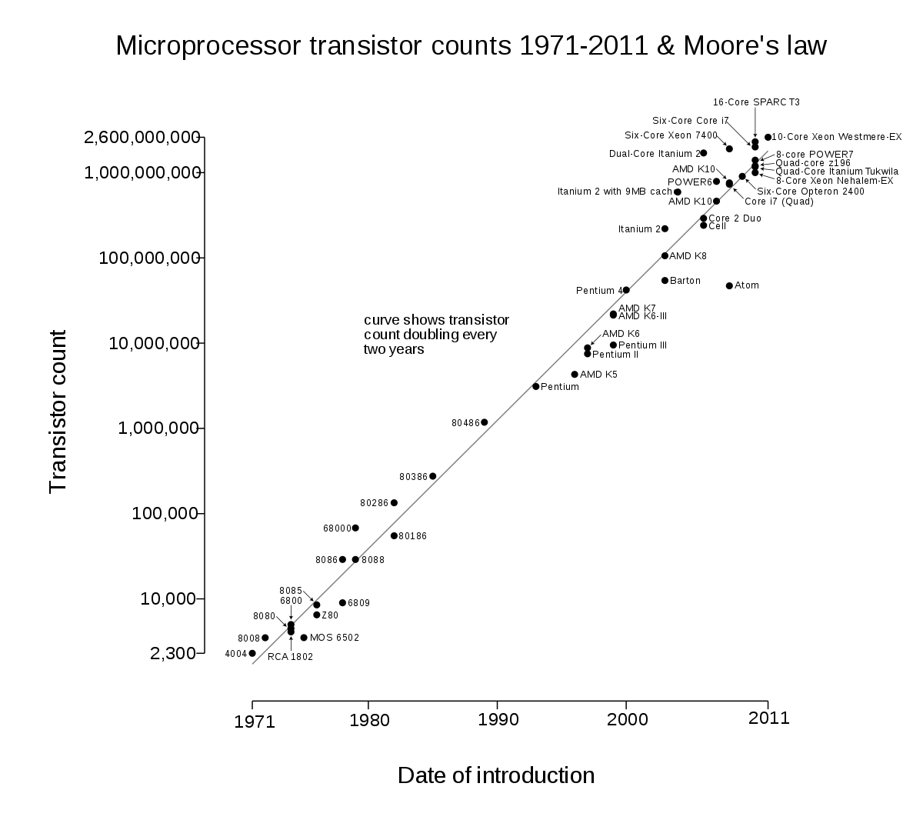
History
Moore's law is the observation that the number of transistors in a dense integrated circuit (IC) doubles about every two years.

Slide 12
History
Software Systems were announced and could not be delivered on time.
The problems were too complex.
The difficulties brought big companies to the brink of collapse.
In 1968 a conference sponsored by NATO was dedicated to the topic (1968 at Garmisch-Partenkirchen, Germany)
In the conference, the difficulties were openly discussed and confessed with unusual frankness, and the terms software engineering and software crisis were coined.

Slide 13
What is Engineering?
Engineering is a scientific field and job that involves taking our scientific understanding of the natural world and using it to invent, design, and build things to solve problems and achieve practical goals.

Slide 14
Introduction to Software Engineering
What is Software Engineering?
IEEE defines software engineering as: (1) The application of a systematic, disciplined, quantifiable approach to the development, operation and maintenance of software; that is, the application of engineering to software. (2) The study of approaches as in the above statement.
Software engineering is concerned with theories, methods and tools for professional software development.
Software engineering is an engineering discipline that is concerned with all aspects of software production from the early stages of system specification through to maintaining the system after it has gone into use.

Slide 15
Why Software Engineering?
We need to be able to produce reliable and trustworthy systems economically and quickly.
It is usually cheaper, in the long run, to use software engineering methods and techniques for software systems rather than just write the programs as if it was a personal programming project.
For most types of system, the majority of costs are the costs of changing the software after it has gone into use.
Software Engineering ensures that good software are developed.
Expenditure on software represents a significant fraction of GNP in all developed countries

Slide 16
Attributes of good software
Maintainability:
Evolve to meet the changing needs of customers.
Dependability:
includes reliability, security and safety.
Efficiency:
responsiveness, processing time, memory utilisation, etc.
Acceptability:
understandable, usable and compatible with other systems that the customers use.

Slide 17
General issues affecting software
Heterogeneity
Increasingly, systems are required to operate as distributed systems across networks that include different types of computer and mobile devices
Business and social change
Business and society are changing incredibly quickly as emerging economies develop and new technologies become available. They need to be able to change their existing software and to rapidly develop new software
Security and trust
As software is intertwined with all aspects of our lives, it is essential that we can trust that software

Slide 18
Software Engineering, Computer Science, System Engineering
Computer science focuses on theory and fundamentals; software engineering is concerned with the practicalities of developing and delivering useful software.
System engineering is concerned with all aspects of computer-based systems development including hardware, software and process engineering. Software engineering is part of this more general process.

Slide 19
Software Engineering Diversity
There are many different types of software system and there is no universal set of software techniques that is applicable to all of these.
The software engineering methods and tools used depend on the type of application being developed, the requirements of the customer and the background of the development team

Slide 20
Application Types
Stand-alone applications
These are application systems that run on a local computer, such as a PC. They include all necessary functionality and do not need to be connected to a network.
Interactive transaction-based applications
Applications that execute on a remote computer and are accessed by users from their own PCs or terminals. These include web applications such as e-commerce applications.
Embedded control systems
These are software control systems that control and manage hardware devices. Numerically, there are probably more embedded systems than any other type of system.

Slide 21
Application Types – contd..
Batch processing systems
These are business systems that are designed to process data in large batches. They process large numbers of individual inputs to create corresponding outputs.
Entertainment systems
These are systems that are primarily for personal use and which are intended to entertain the user
Systems for modeling and simulation
These are systems that are developed by scientists and engineers to model physical processes or situations, which include many, separate, interacting objects

Slide 22
Application Types – contd..
Data collection systems
These are systems that collect data from their environment using a set of sensors and send that data to other systems for processing
Systems of systems
These are systems that are composed of a number of other software systems

Slide 23
Case Studies
A case study is a particular instance of something used or analyzed in order to illustrate a thesis or principle.
An embedded insulin pump control system
A system for mental health care patient management
A wilderness weather station

Slide 24
A personal insulin pump

Slide 25
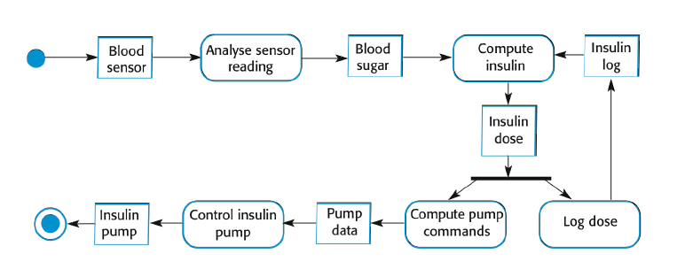
A personal insulin pump – Activity Model

Slide 26
Essential high-level requirements of Insulin - Pump
The system shall be available to deliver insulin when required.
The system shall perform reliably and deliver the correct amount of insulin to counteract the current level of blood sugar.
The system must therefore be designed and implemented to ensure that the system always meets these requirements.

Slide 27
A patient information system for mental health care
A patient information system to support mental health care is a medical information system that maintains information about patients suffering from mental health problems and the treatments that they have received
Most mental health patients do not require dedicated hospital treatment but need to attend specialist clinics regularly where they can meet a doctor who has detailed knowledge of their problems
To make it easier for patients to attend, these clinics are not just run in hospitals. They may also be held in local medical practices or community centres.

Slide 28
MHC-PMS
The MHC-PMS (Mental Health Care-Patient Management System) is an information system that is intended for use in clinics.
It makes use of a centralized database of patient information but has also been designed to run on a PC, so that it may be accessed and used from sites that do not have secure network connectivity
When the local systems have secure network access, they use patient information in the database but they can download and use local copies of patient records when they are disconnected

Slide 29
MHC-PMS goals
To generate management information that allows health service managers to assess performance against local and government targets.
To provide medical staff with timely information to support the treatment of patients.

Slide 30
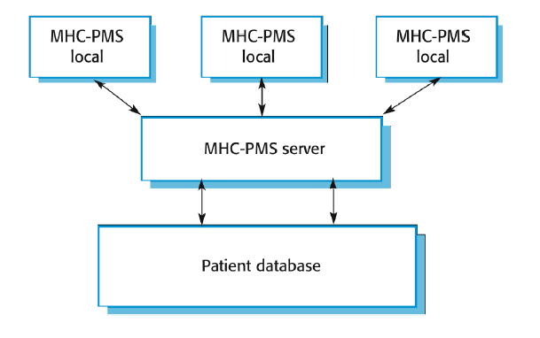
The organization of the MHC-PMS

Slide 31
MHC-PMS key features
Individual care management
Clinicians can create records for patients, edit the information in the system, view patient history, etc. The system supports data summaries so that doctors can quickly learn about the key problems and treatments that have been prescribed.
Patient monitoring
The system monitors the records of patients that are involved in treatment and issues warnings if possible problems are detected
Administrative reporting
The system generates monthly management reports showing the number of patients treated at each clinic, the number of patients who have entered and left the care system, number of patients sectioned, the drugs prescribed and their costs, etc.

Slide 32
MHC-PMS concerns
Privacy
It is essential that patient information is confidential and is never disclosed to anyone apart from authorised medical staff and the patient themselves
Safety
Some mental illnesses cause patients to become suicidal or a danger to other people. Wherever possible, the system should warn medical staff about potentially suicidal or dangerous patients.
The system must be available when needed otherwise safety may be compromised and it may be impossible to prescribe thecorrect medication to patients

Slide 33
Wilderness Weather Station
The government of a country with large areas of wilderness decides to deploy several hundred weather stations in remote areas .
Weather stations collect data from a set of instruments that measure temperature and pressure, sunshine, rainfall, wind speed and wind direction
The weather station includes a number of instruments that measure weather parameters such as the wind speed and direction, the ground and air temperatures, the barometric pressure and the rainfall over a 24-hour period.
Each of these instruments is controlled by a software system that takes parameter readings periodically and manages the data collected from the instruments.

Slide 34
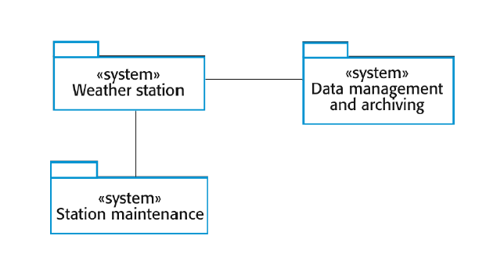
The weather station’s environment

Slide 35
Weather information system
The weather station system
This is responsible for collecting weather data, carrying out some initial data processing and transmitting it to the data management system.
The data management and archiving system
This system collects the data from all of the wilderness weather stations, carries out data processing and analysis and archives the data.
The station maintenance system
This system can communicate by satellite with all wilderness weather stations to monitor the health of these systems and provide reports of problems.

Slide 36
Additional software functionality
Monitor the instruments, power and communication hardware and report faults to the management system.
Manage the system power, ensuring that batteries are charged whenever the environmental conditions permit but also that generators are shut down in potentially damaging weather conditions, such as high wind.
Support dynamic reconfiguration where parts of the software are replaced with new versions and where backup instruments are switched into the system in the event of system failure.

Slide 37
Software Engineering Ethics
Confidentiality
Engineers should normally respect the confidentiality of their employers or clients irrespective of whether or not a formal confidentiality agreement has been signed
Competence
Engineers should not misrepresent their level of competence. They should not knowingly accept work which is outwith their

Slide 38
Software Engineering Ethics contd..
Intellectual property rights
Engineers should be aware of local laws governing the use of intellectual property such as patents, copyright, etc. They should be careful to ensure that the intellectual property of employers and clients is protected.
Computer misuse
Software engineers should not use their technical skills to misuse other people’s computers. Computer misuse ranges from relatively trivial (game playing on an employer’s machine, say) to extremely serious (dissemination of viruses).

Slide 39
References
Software Engineering, 9th Ed. Ian Sommerville. Pearson Education
Software Engineering: A Practitioner’s Approach, 6th Ed. Roger S. Pressman, McGraw-Hill, 2009

Slide 40
Questions

